Slide 1
Operation Analytics and Investigating Metric Spike
BY:DEEPTIRANI BENIA

Slide 2
Project Description
Provide a brief overview of the project, explaining its purpose and how you plan to handle the analysis.
Project Description
Provide a brief overview of the project, explaining its purpose and how you plan to handle the analysis.
Project Description:
The project consist of two case studies. The first focuses on Operational Analysis. Operational Analytics is a crucial process that involves analyzing a company's end-to-end operations. This analysis helps identify areas for improvement within the company. In the project job data is given and Jobs Reviewed Over Time ,Throughput Analysis, Language Share Analysis, Duplicate Rows Detection are found out.
The second is about Investigating Metric Spike where Weekly User Engagement, User Growth Analysis ,Weekly Retention Analysis, Weekly Engagement Per Device ,Weekly Engagement Per Device is determined.
In this project I am taking the role of a Lead Data Analyst at a company like Microsoft. With the provided various datasets and tables, and my task is to derive insights from this data to answer questions posed by different departments within the company.
The goal is to use advanced SQL skills to analyze the data and provide valuable insights that can help improve the company's operations and understand sudden changes in key metrics.
The following information is found with the help of SQL queries.

Slide 3
Approach:
The project is developed using SQL workbench.At first I created database by using dataset provided by the company.then the data was loaded into SQL workbench and analysis was performed .
TECH STACK USED:
MY SQL Workbench 8.0
MS EXCEL

Slide 4
Insights:
Case Study 1: Job Data Analysis
The details of the dataset provided are:
job_id: Unique identifier of jobs
actor_id: Unique identifier of actor
event: The type of event (decision/skip/transfer).
language: The Language of the content
time_spent: Time spent to review the job in seconds.
org: The Organization of the actor
ds: The date in the format yyyy/mm/dd (stored as text).

Slide 5
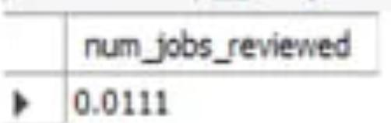
Tasks 1:Jobs Reviewed Over Time:
Objective: Calculate the number of jobs reviewed per hour for each day in November 2020.
My Task: Write an SQL query to calculate the number of jobs reviewed per hour for each day in November 2020.
QUERY:
SELECT * from job_data;
SELECT avg(t) as 'avg job reviewed per day per hour',
avg(p) as 'avg job reviewed per day per second'
from
(select ds,
((count(job_id)*3600)/sum(time_spent)) as t,
((count(job_id))/sum(time_spent))as p
from
job_data
where month(ds)=11
group by ds)a;

Slide 6
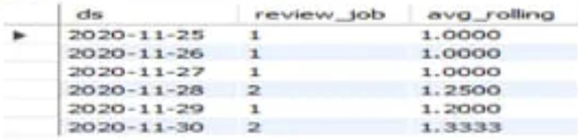
Tasks 2:Throughput Analysis:
Objective: Calculate the 7-day rolling average of throughput (number of events per second).
My Task: Write an SQL query to calculate the 7-day rolling average of throughput. Additionally, explain whether you prefer using the daily metric or the 7-day rolling average for throughput, and why.
QUERY:
select ROUND(COUNT(event)/SUM(time_spent), 2)AS "Weekly Throughput" from job_data; select ds as Dates, ROUND(COUNT(event)/SUM(time_spent), 2) AS "Daily Throughput" from job_data GROUP BY ds ORDER BY ds;

Slide 7
Task3:Language Share Analysis: Objective: Calculate the percentage share of each language in the last 30 days. My Task: Write an SQL query to calculate the percentage share of each language over the last 30 days. QUERY: SELECT LANGUAGE, ROUND(100 * COUNT(*)/total, 2)as percentage, sub.total
from job_data
CROSS JOIN (SELECT COUNT(*) AS total FROM job_data)AS sub
GROUP BY LANGUAGE, sub.total;
English | 12.50 | 16
Arabic | 12.50 | 16
Persian | 37.50 | 16
Hindi | 12.50 | 16
French | 12.50 | 16
Italian | 12.50 | 16

Slide 8
TASK4:Duplicate Rows Detection:
Objective: Identify duplicate rows in the data.
My Task: Write an SQL query to display duplicate rows from the job_data table.
QUERY:
SELECT actor_id, COUNT(*) AS Duplicates FROM job_dataGROUP BY actor_id HAVING COUNT(*) >1;
1001 | 2
1006 | 2
1003 | 4
1005 | 2
1002 | 2
1007 | 2
1004 | 2

Slide 9
Case Study 2: Investigating Metric Spike
users: Contains one row per user, with descriptive information about that user’s account.
events: Contains one row per event, where an event is an action that a user has taken (e.g., login, messaging, search).
email_events: Contains events specific to the sending of emails.

Slide 10
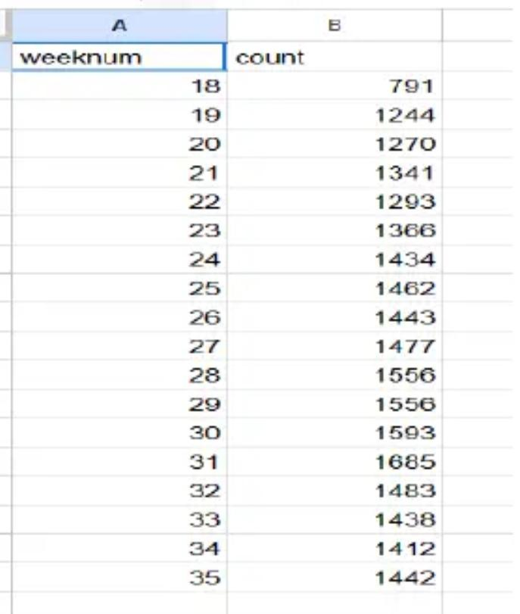
Tasks 1:Weekly User Engagement:
Objective: Measure the activeness of users on a weekly basis.
My Task: To calculate the weekly user engagement.

Slide 11
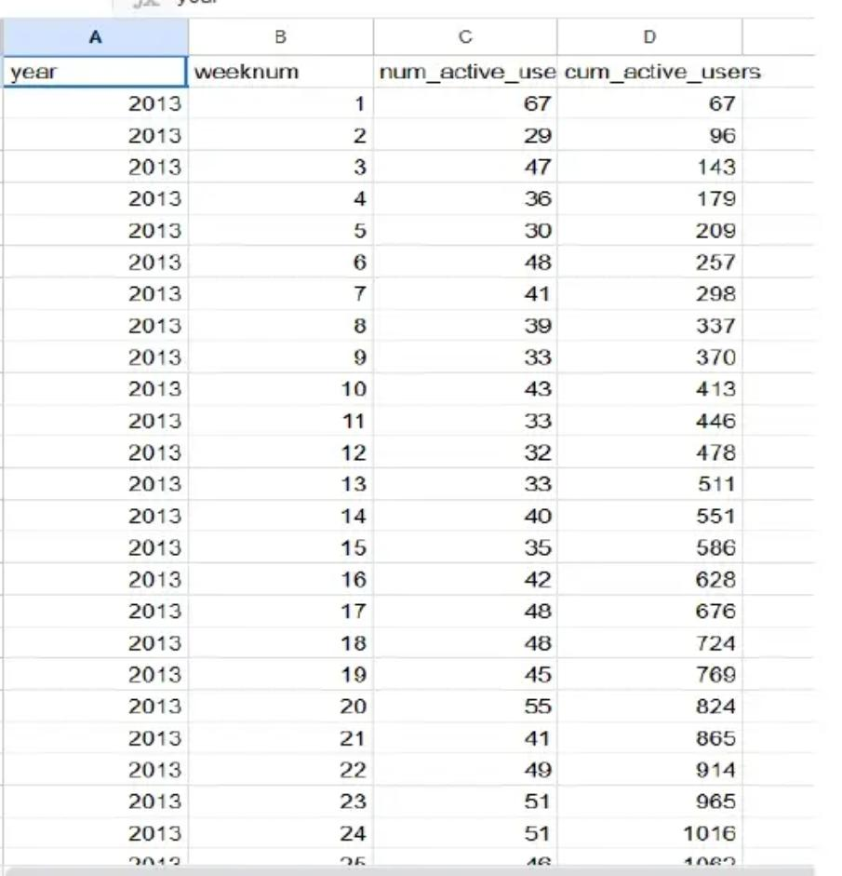
Tasks 2:User Growth Analysis:
Objective: Analyze the growth of users over time for a product.
My Task: Write an SQL query to calculate the user growth for the product.

Slide 12
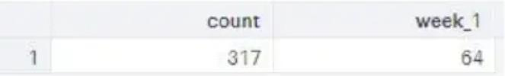
Tasks 3:Weekly Retention Analysis:
Objective: Analyze the retention of users on a weekly basis after signing up for a product.
My Task: Write an SQL query to calculate the weekly retention of users based on their sign-up cohort.

Slide 13
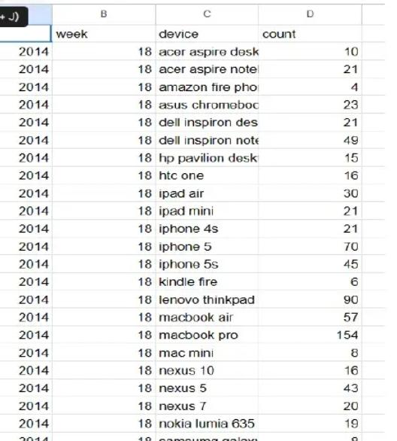
Task 4:Weekly Engagement Per Device:
Objective: Measure the activeness of users on a weekly basis per device.
MyTask: Write an SQL query to calculate the weekly engagement per device.

Slide 14
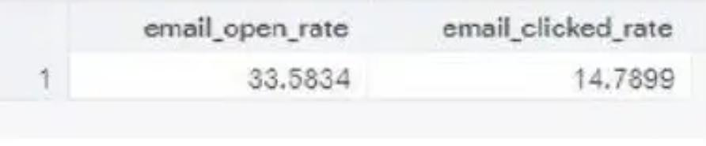
Tasks 5:Email Engagement Analysis:
Objective: Analyze how users are engaging with the email service.
My Task: Write an SQL query to calculate the email engagement metrics.

Slide 15
Conclusion :Through this research, I learned how crucial Operational Analytics is for firms because it aids in discovering and recognizing areas for improvement. In this project, I was able to gain insights into various questions such as the rate of job reviews, language share, patterns of user engagement on a weekly basis, user growth, and so on, which I can communicate to the management team as needed so that they can make appropriate data-driven decisions.

